Slide 1
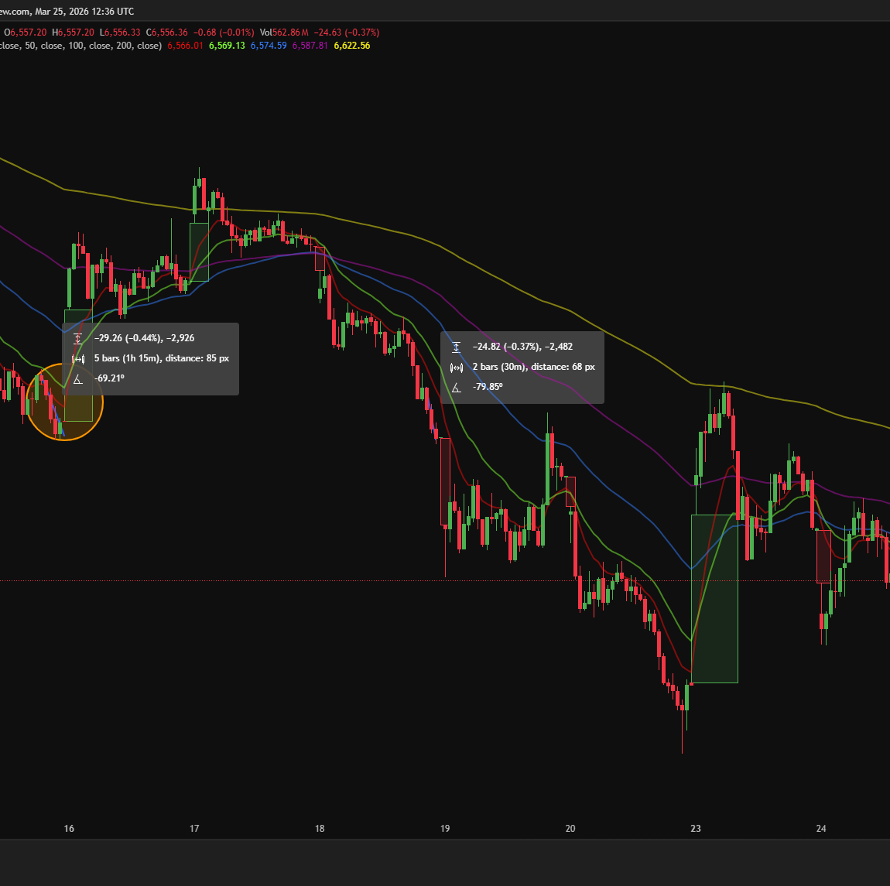
Predicting End-of-Day Market Moves for Options Trading
In the last hour of trading (3pm–4pm), markets often move quickly
These moves can create short-term trading opportunities
The goal is to predict whether the market will go up, down, or stay stable

Slide 2
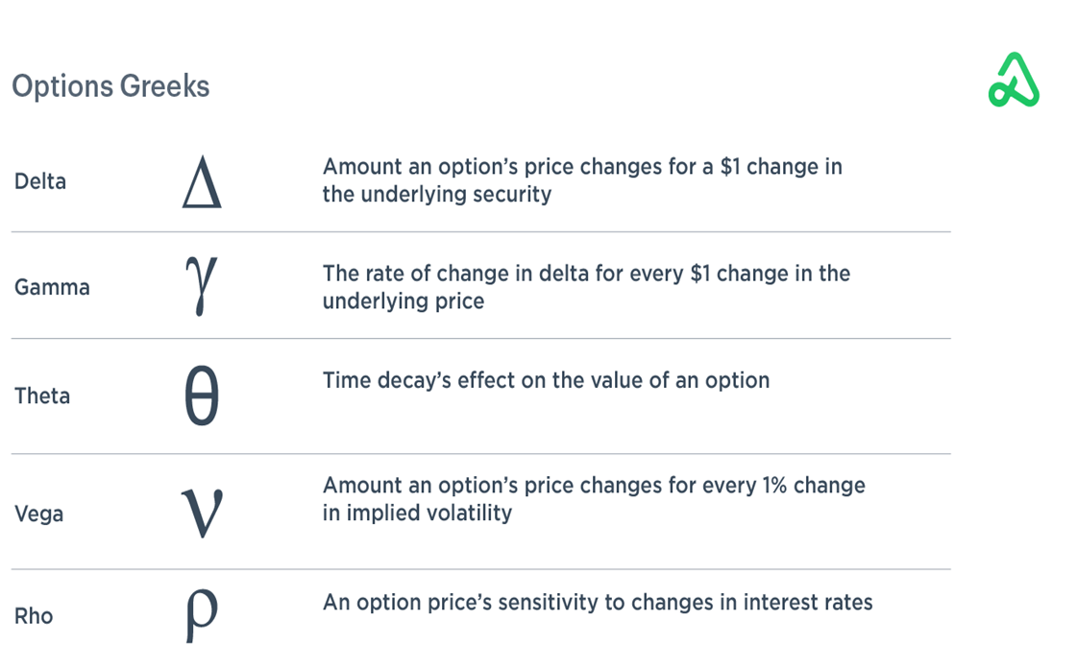
Key Concepts
Intraday Data : Data collected during the day (every few minutes)
Volatility: How much the market is moving
VIX (Volatility Index) :Often called the “fear index”
Momentum: Whether the market is trending up or down
Options Data: Information from the options market (bets on future price moves)
Gamma Exposure (Gamma Pool) : Measures how options traders might affect the market itself

